Slide 1
Lab Meeting 8/16
Luke Ting

Slide 2
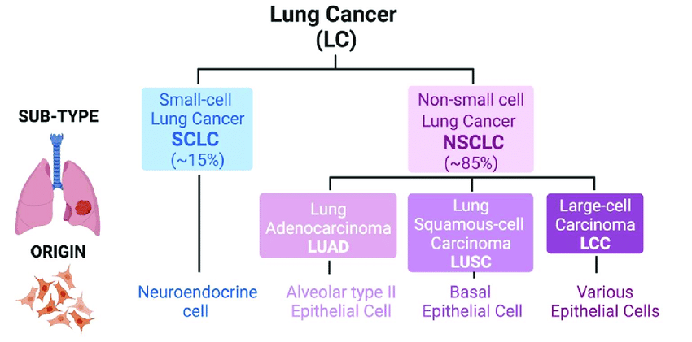
Lung Cancer
NSCLC (~85%)
Adenocarcinoma
Squamous cell carcinoma
MAPK and targeted therapies
SCLC (~15%)
Neuroendocrine
p53 and Rb loss of function
5-year relative survival rates
NSCLC 28%
SCLC 7%
10.3390/cells10081879

Slide 3
Large Cell Neuroendocrine Carcinoma (LCNEC)
Has features of both SCLC and NSCLC
Comprises 1-3% of all lung cancers
Median overall survival of 8-12 months
Neuroendocrine architecture, prominent nucleoli, high mitotic rate, extensive necrosis
Expresses at least one of these NE markers by IHC: chromogranin A, synaptophysin, CD56
Early stage: surgery + adjuvant chemo. For nonresectable, RT + chemo
Late stage: platinum-etoposide

Slide 4
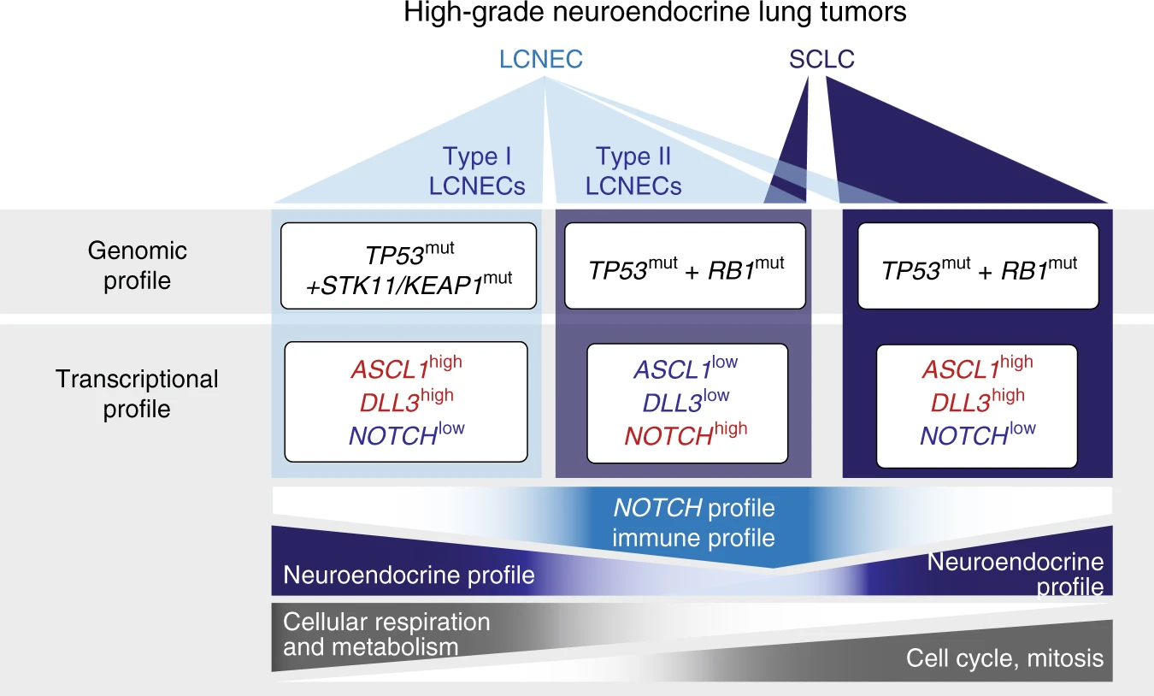
Two types of LCNEC
Type 1: TP53 and STK11/KEAP1 mutations (common in NSCLC) and NE phenotype.
Type 2: TP53 and RB1 mutations (found in nearly all SCLC) and reduced NE phenotype
KRAS mutations and other Ras pathway activating mutations enriched in Type 1
PI3K/Akt/mTOR pathway activity present in both types
If tumor is Rb WT or expresses RB, patient responds better to NSCLC-GEM/TAX compared to SCLC-PE. Studies show conflicting results
Type 2 LCNEC responds better to SCLC-PE
10.1038/s41467-018-03099-x

Slide 5
Project background
We have roughly 13 cell lines that appear to be LCNEC. Some of these are not classified as LCNEC
Are these cell lines models of LCNEC? Do they have features of LCNEC?
Cell lines are growing in mice and histological samples will be evaluated by pathologists
In LCNEC, ASCL1 and MAPK pathways can coexist. How is this possible?
If ASCL1 is turned on during the transformation from NSCLC to SCLC, why is it not tolerated in NSCLC yet tolerated in LCNEC?
Does inhibiting one pathway upregulate the other?
My summer project
ASCL1 and/or NEUROD1 RNA is expressed. Is the protein expressed?
Just because Rb gene is WT, does not mean Rb is expressed. Western blot is needed to determine if Rb is present. Which cell lines are Type I or Type II?
For LCNECs that have WT Rb protein, do they have loss of p16?
To what extent do KRAS inhibitors inhibit the MAPK pathway in LCNEC cell lines? Is the KRAS mutant functional?

Slide 6
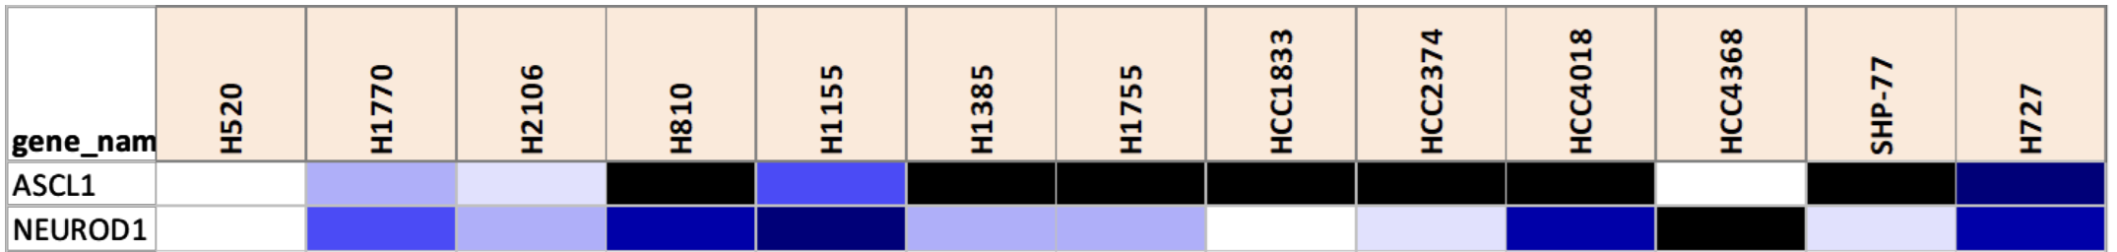



LCNEC express ASCL1 or NEUROD1
RNA
H2081
H441
H1755
H1155
H727
HCC2374
ASCL1
RNA expression of ASCL1 and NEUROD1 correspond to protein expression
Some LCNEC express ASCL1, NEUROD1, or both
Positive control issues
NEUROD1
GAPDH
Different SCLC subtypes: SCLC-A, SCLC-B, and SCLC-P
Similarly, we see that some LCNEC have high levels of ASCL1 and others have high levels of NEUROD1

Slide 7
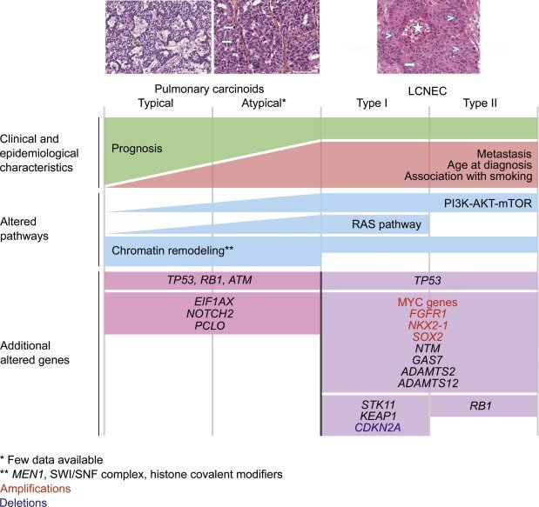
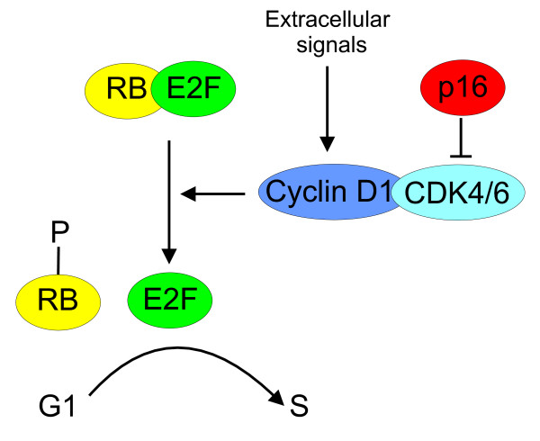
Rb and p16 significance in LCNEC
Loss of Rb and loss of p16 tend to be mutually exclusive
Losing p16 and Rb would have the similar effects
p16 inhibits CDK 4/6, thereby keeping Rb active and bound to E2F. Cell remains in G1
Type II LCNEC have Rb mutations while Type I may have loss of p16 (CDKN2A)
10.1186/bcr3376
10.1016/j.jtho.2018.02.002

Slide 8
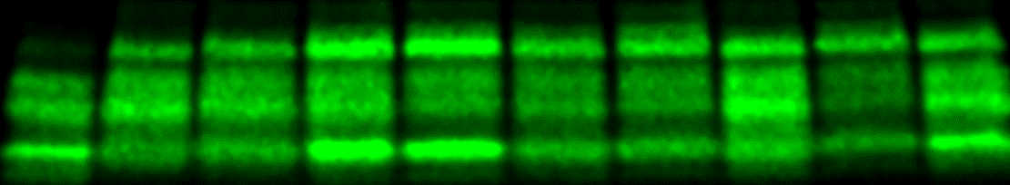
Rb and p16 Western blot
H2081
H441
H727
H810
H1155
H1385
H1755
HCC1833
HCC4018
SHP77
Ladder
Rb
100 kD
HSP90
p16
Control for Rb worked
H1155 and SHP77 likely have loss of Rb

Slide 9
Preliminary Classification of LCNEC Models

Slide 10
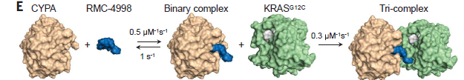
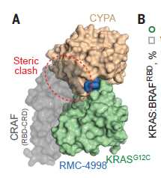
Mechanism of RMC-6236 Based on the
Tool Compound RMC-4998
Schulze et al., Science 381, 794–799 (2023) 18 August 2023

Slide 11
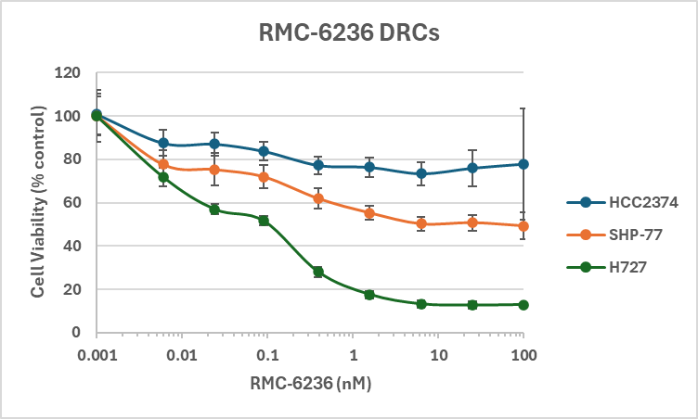
Credit: Mike Peyton

Slide 12




pERK Levels decrease after treatment with KRAS inhibitor
ERK
pERK
SHP77
H727
HCC2374
SHP77
H727
HCC2374
RMC-6236 (10nM)
-
+
-
+
-
+
RMC-6236 (10nM)
-
+
-
+
-
+
ERK
pERK
GAPDH
GAPDH
The relative effectiveness of the inhibitor in these 3 cell lines according to DRCs matches with Western blot data
KRAS inhibitor decreased active form of the downstream ERK
Notes:
The three cell lines have KRAS G12V mutation

Slide 13
Summary
Of the four cell lines tested, the cells have protein expression of ASCL1, NEUROD1 or both
2 out of the 8 cell lines tested express no Rb protein and are likely Type 2 LCNEC
Will be working on p16 blot
The RMC-6236 inhibitor reduces the amount of pERK in 3 cell lines with KRAS G12V mutation to varying degrees and this correlates with growth inhibition

Slide 14
Future directions
Find protein expression of p16 in LCNEC cell lines. Do more blots and include more cell lines
Knockout ASCL1 and measure cell viability and apoptosis
Rescue cell lines treated with RMC 6236 using active MEK
Perform westerns to determine whether ASCL1 is upregulated when MAPK pathway is inhibited and vice versa
Drug assays that provides cell response over time could help determine how dependent the cell lines are on MAPK pathway
Find out how the two types of LCNEC respond to SCLC chemotherapy and NSCLC chemotherapy
Evaluate the effectiveness of DLL3 inhibitors and immune checkpoint inhibitors
Evaluate the effectiveness of these treatments in mice models
Clinical trials

Slide 15
Acknowledgements
Minna Lab
John Minna
Michael Peyton
Kim Avila
Buddy Huffman
Boning Gao
Long Shan Li
Luc Girard
Mahboubeh Papari-Zareei
Victor Stastny
Drapkin Lab​
Benjamin Drapkin​
Alyssa Cordes​
Shreoshi Pal Choudhuri
Shruti Raghavan
Di Yang
Seth Hamilton

